Slide 1
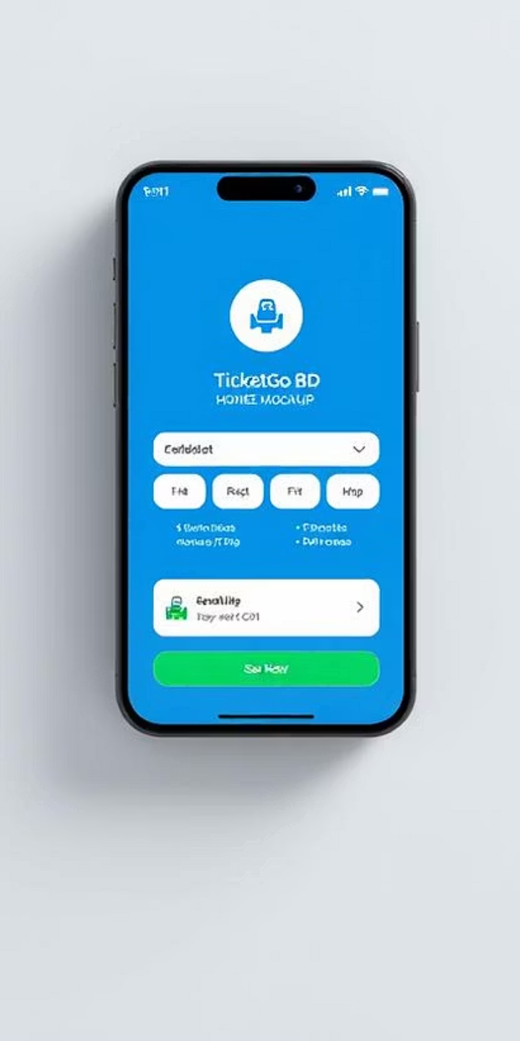
Ticket Booking App
Book your Bus and Train Tickets Anytime, Anywhere in Bangladesh
A mobile app that allows users to search, book, and manage bus and train tickets with real-time availability and digital payments.

Slide 2
The Problem & Our Solution
The Problem
Manual ticketing is slow, crowded, and lacks transparency.
Rural and urban passengers need a reliable digital system.
Our Solution
It offers easy access to transport info and booking in one place.

Slide 3





Key Features
Search buses/trains by location and date
Real-time seat selection
QR code-based e-ticket
User account, booking history, and refunds
Notifications for delays or changes

Slide 4
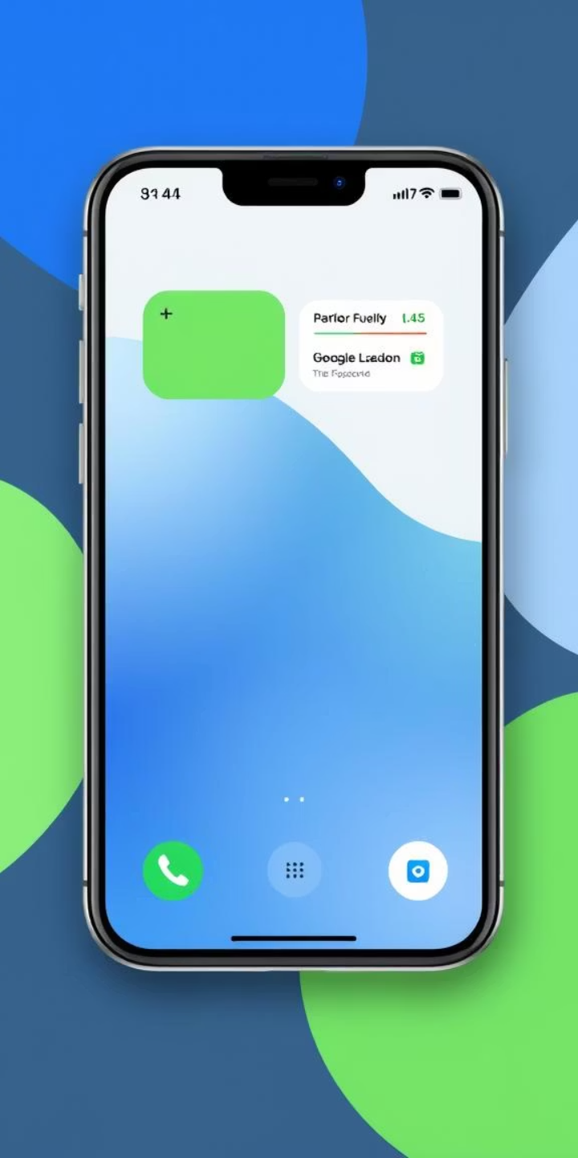
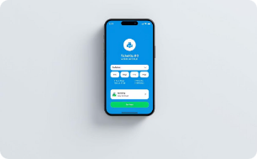
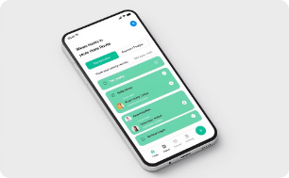
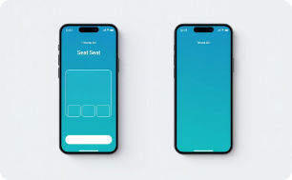
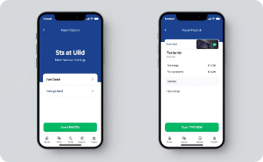
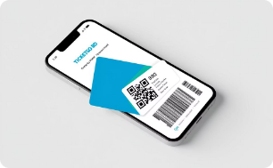
Clean & Friendly User Interface
Home screen
Route search
Seat selection
Payment page
Ticket display with QR code
Optimized for both Bengali and English users

Slide 5






Future Plans & Improvements
Live bus/train tracking with GPS
Offline ticket booking for rural agents
Loyalty rewards for regular users
Expand to launch website version
Add voice search and chatbot help
Admin panel for transport companies
Let’s make travel in Bangladesh smarter and easier for everyone.

Slide 6

Meet Our Team
1
Masud Rana
2
Nazmul
3
Tushar
Team Leader & Backend Developer
Research & Integration Expert (collects bus/train data, manages payment APIs)
UI/UX & Frontend Developer (builds app screens and interactions)

Slide 7
Thank You for Your Time!
We appreciate your interest in Ticket Booking. Together, we can make travel in Bangladesh smarter and easier
for everyone.
For more information or inquiries, please feel free to contact us.

